Slide 1
Missile Interception with Reachability Tools
Thesis Preparation

Slide 2
Introduction
STATE OF THE ART
PROBLEM FORMULATION
PROBLEM SOLUTION
PRIOR WORK
SCHEDULE
Missile defense in urban areas is challenging.
Quad-rotor UAVs are widely deployable and versatile.
Much work has been done to turn them into defense platforms.
However, there is a need for a quad-rotor flight controller that incorporates reachability analysis.

Slide 3
Introduction
STATE OF THE ART
PROBLEM FORMULATION
PROBLEM SOLUTION
PRIOR WORK
SCHEDULE
Most solutions are optimal control-based (LQR, NMPC, CBF-CLF).
Provides the best result according to the cost function used and are robust to perturbations.
Cannot guarantee trajectory feasibility on their own.
There is a gap in research of Reachability-based interception controllers, which can provide safety guarantees.

Slide 4
Introduction
STATE OF THE ART
PROBLEM FORMULATION
PROBLEM SOLUTION
PRIOR WORK
SCHEDULE
Missile defense in urban areas is challenging.
Quad-rotor UAVs are widely deployable and versatile.
Much work has been done to turn them into defense platforms.
However, there is a need for a quad-rotor flight controller that incorporates reachability analysis.

Slide 5
Introduction
STATE OF THE ART
PROBLEM FORMULATION
PROBLEM SOLUTION
PRIOR WORK
SCHEDULE
Missile defense in urban areas is challenging.
Quad-rotor UAVs are widely deployable and versatile.
Much work has been done to turn them into defense platforms.
However, there is a need for a quad-rotor flight controller that incorporates reachability analysis.

Slide 6
Introduction
STATE OF THE ART
PROBLEM FORMULATION
PROBLEM SOLUTION
PRIOR WORK
SCHEDULE
Missile defense in urban areas is challenging.
Quad-rotor UAVs are widely deployable and versatile.
Much work has been done to turn them into defense platforms.
However, there is a need for a quad-rotor flight controller that incorporates reachability analysis.

Slide 7
Introduction
STATE OF THE ART
PROBLEM FORMULATION
PROBLEM SOLUTION
PRIOR WORK
SCHEDULE
Missile defense in urban areas is challenging.
Quad-rotor UAVs are widely deployable and versatile.
Much work has been done to turn them into defense platforms.
However, there is a need for a quad-rotor flight controller that incorporates reachability analysis.

Slide 8
Introduction
Missile defense in urban areas is challenging.
Quad-rotor UAVs are widely deployable and versatile.
Much work has been done to turn them into defense platforms.
However, there is a need for a quad-rotor flight controller that incorporates reachability analysis.

Slide 9
State of the Art
Intercept type quad-rotor controllers
Most solutions are optimal control-based (LQR, NMPC, CBF-CLF).
Provides the best result according to the cost function used and are robust to perturbations.
Cannot guarantee trajectory feasibility on their own.
There is a gap in research of Reachability-based interception controllers, which can provide safety guarantees.

Slide 10



Problem Formulation
Two player defense-intercept game
Missile Objective Hierarchy:
Static target interception.
Dynamic pursuer evasion.
$${\vec{r}}_{R}\left(k\right)$$
C
$${\vec{d}}_{RC}\left(k\right)$$
R
Drone Objective Hierarchy:
Dynamic target interception.
Static area defense.
$${\vec{d}}_{DR}\left(k\right)$$
D

Slide 11



Problem Formulation
Two player defense-intercept game
$${\vec{r}}_{R}\left(k+1\right)$$
Missile Objective Hierarchy:
Static target interception.
Dynamic pursuer evasion.
$${\vec{d}}_{RC}\left(k+1\right)$$
C
R
$${\vec{d}}_{DR}\left(k+1\right)$$
Drone Objective Hierarchy:
Dynamic target interception.
Static area defense.
D

Slide 12
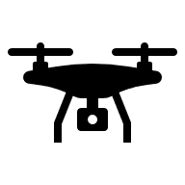

Proposed Solution
Reachability-based Approach
D
R
Reachable space of drone
Reachable space of missile
Critical area
Safety Shadow
C

Slide 13
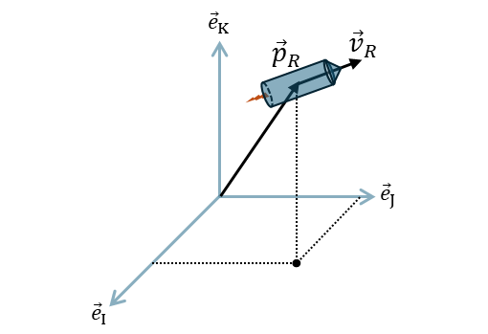
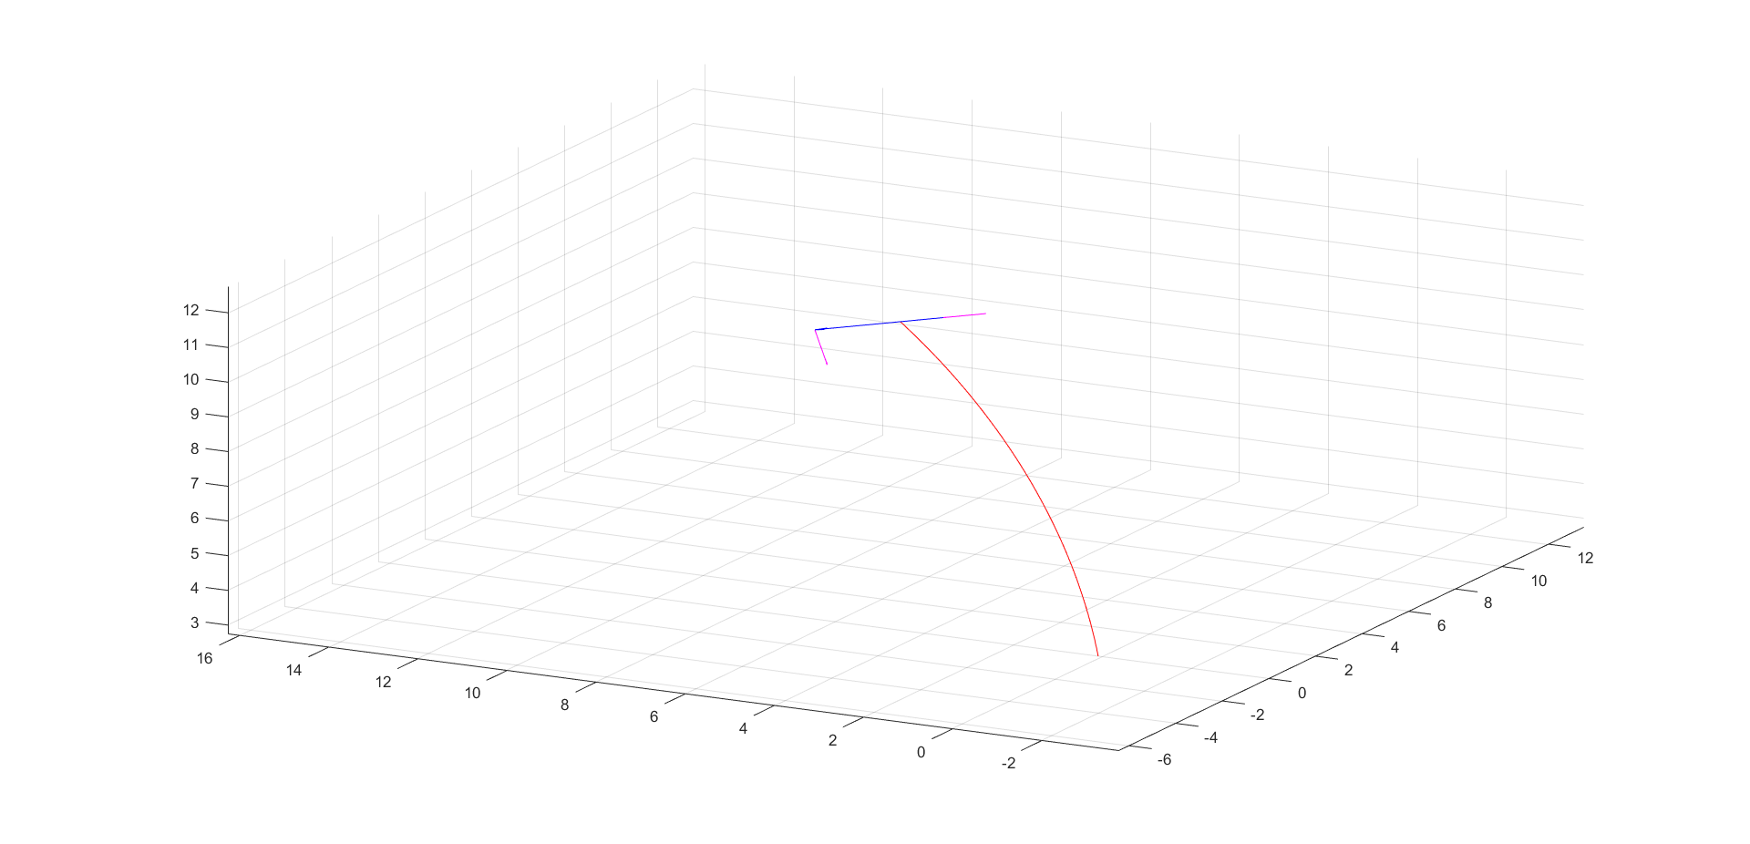
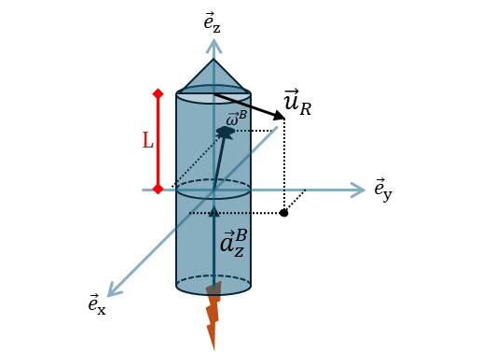
Prior Work
Missile model simulation
Diagram of state variables
MATLAB Simulation

Slide 14
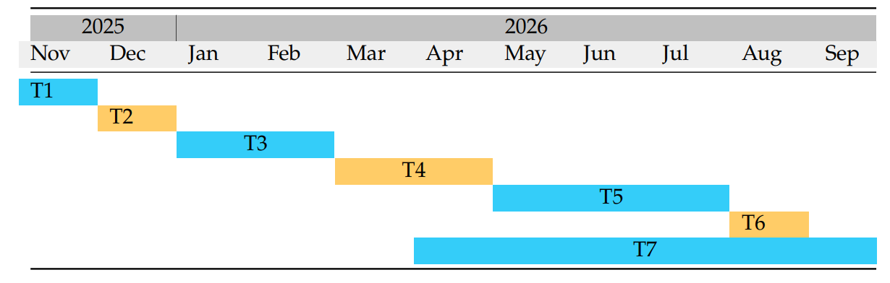
Schedule
Literature Review
Definition of Requirements
Open-Loop Design
Defense-Intercept Algorithm Definition
Controller Validation in Simulation
Test Flight Validation
Writing Thesis

Slide 15
Thank you

